Slide 1
Hierarchical Agglomerative Clustering – HAC Explained
Curated by Dr. Claudia Pearce
For CMSC 476-676 at UMBC
with
Excerpts of talks by Janux (U of Oklahoma) and Anuradha Bhatia,
And Chris Manning’s Book (Cha. 17)

Slide 2
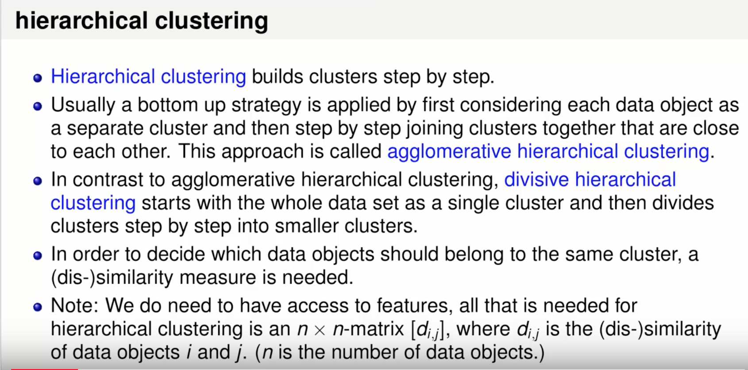
https://www.youtube.com/watch?v=FvFsjdMwANU
Notes:
https://www.youtube.com/watch?v=FvFsjdMwANU
Hierarchical Clustering
“Intelligent Data Analytics“ is an online course on Janux. Learn more at http://janux.ou.edu.
University of Oklahoma

Slide 3
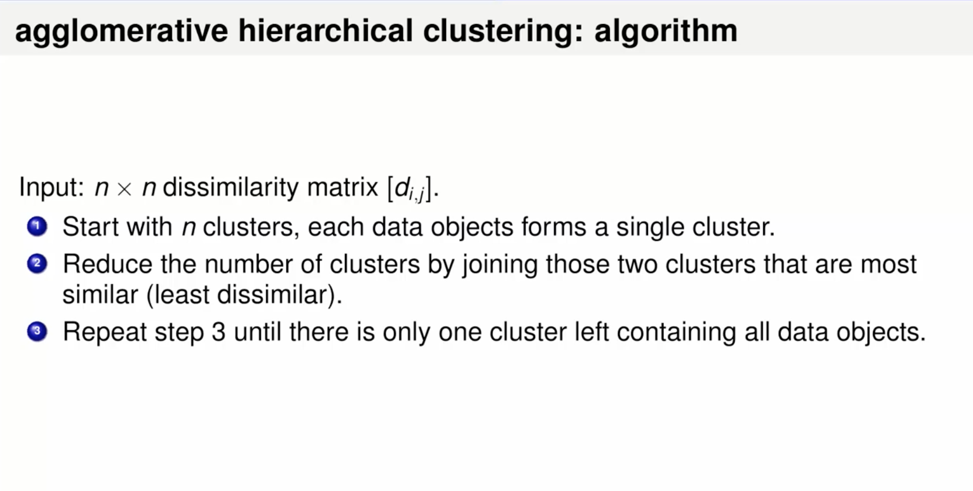
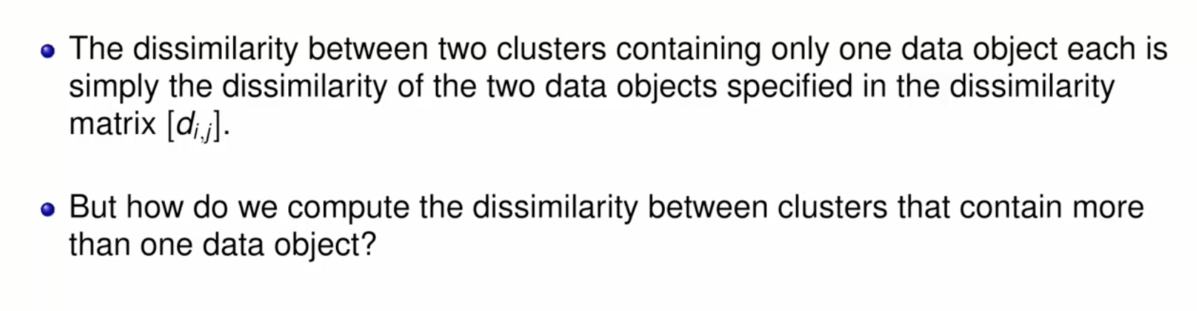

Slide 4
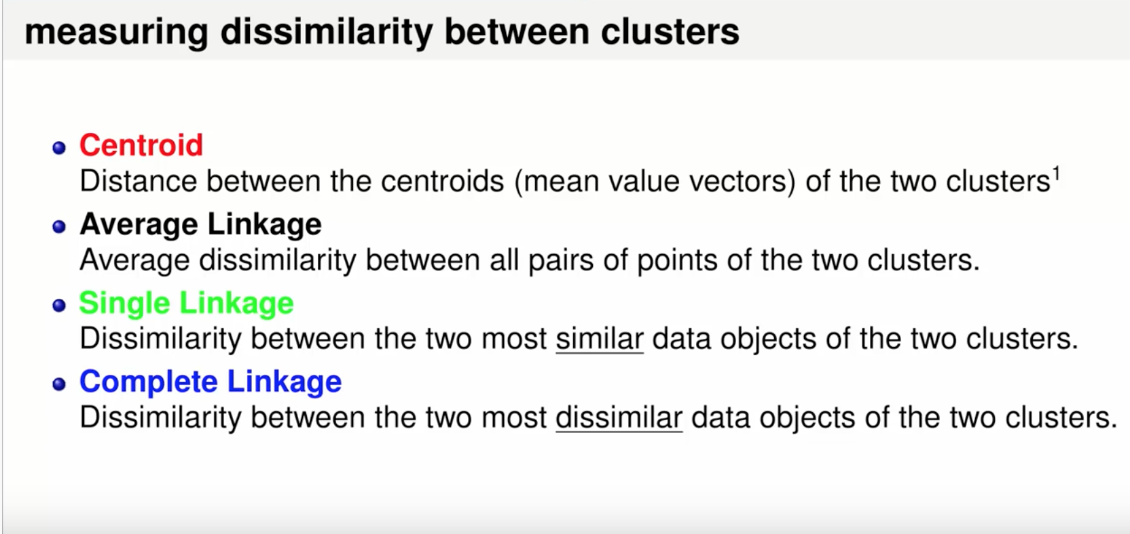

Slide 5
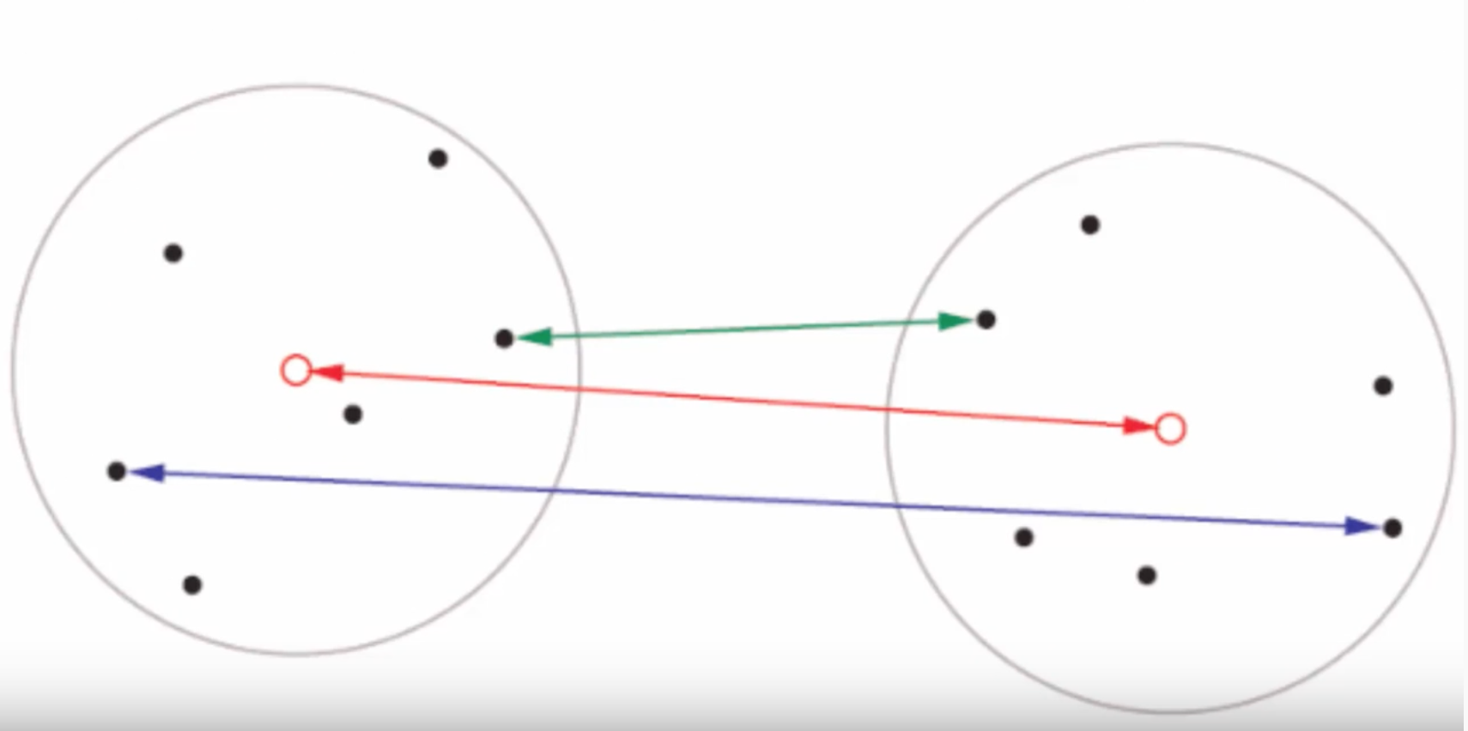

Slide 6
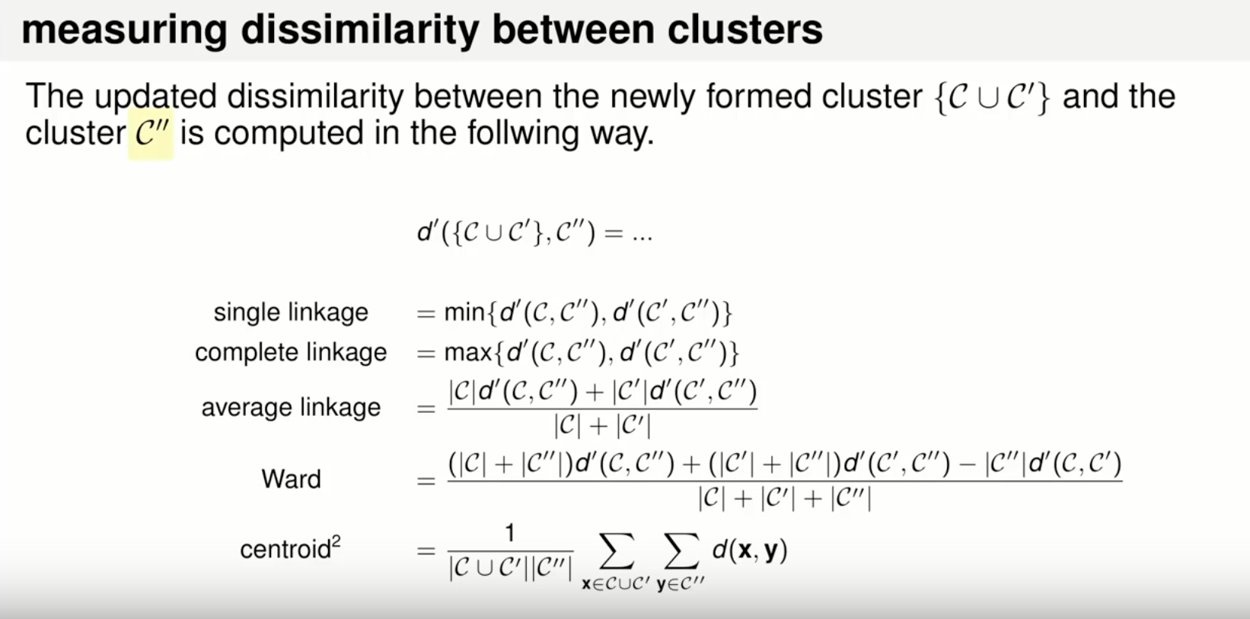

Slide 7
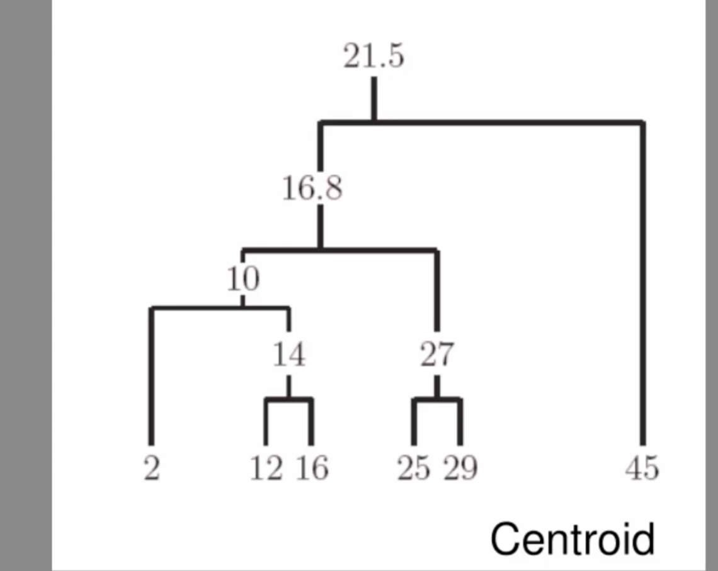

Slide 8
Cluster Average Linkage or Centroid
(12+16)/2=14
(2*14 +2)/3=10
(25+29)/2 = 27
(3*10 + 2*27)/5 = 16.8
(45 + 16.8*5)/6 = 21.5

Slide 9
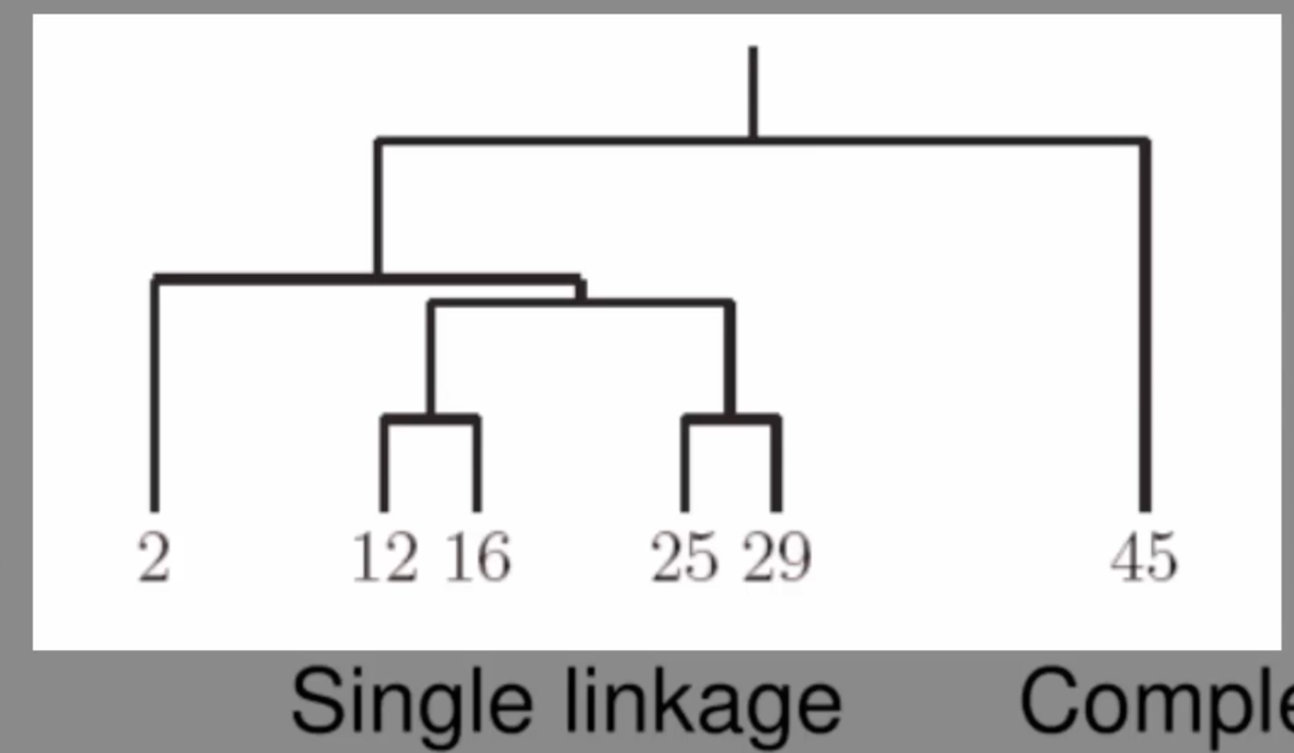

Slide 10
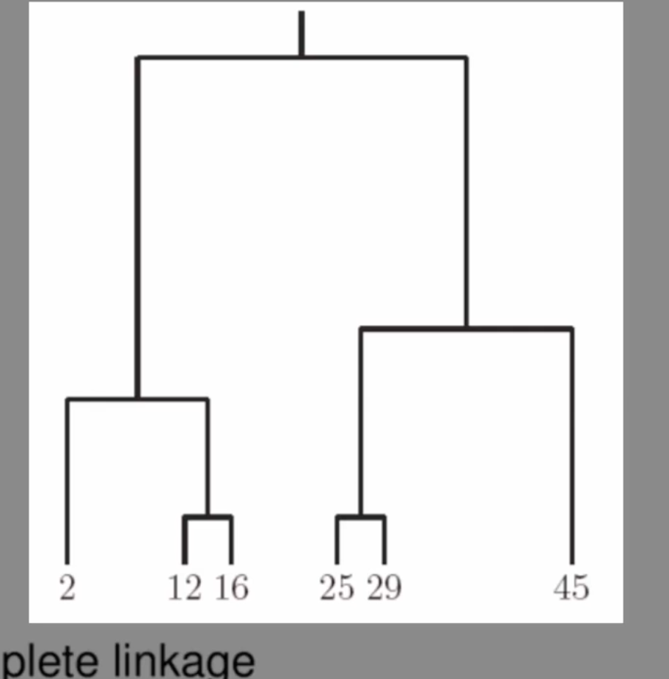


Slide 11
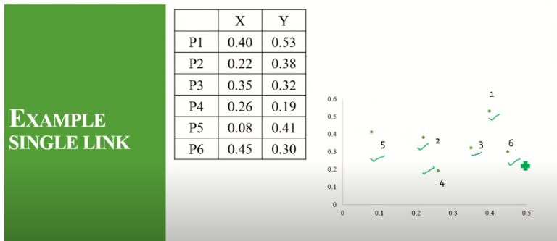

Slide 12

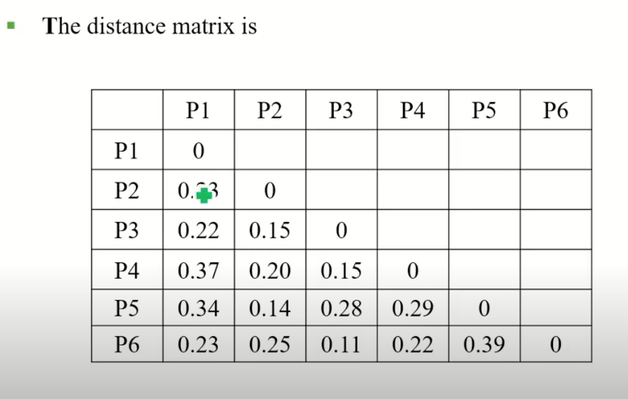
https://www.youtube.com/watch?v=RdT7bhm1M3E
Notes:
Hierarchical Agglomerative Clustering [HAC - Single Link]
https://www.youtube.com/watch?v=RdT7bhm1M3E
Anuradha Bhatia

Slide 13
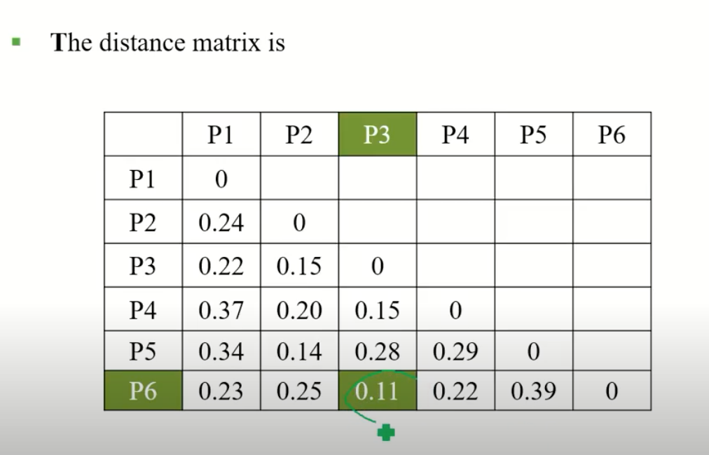

Slide 14
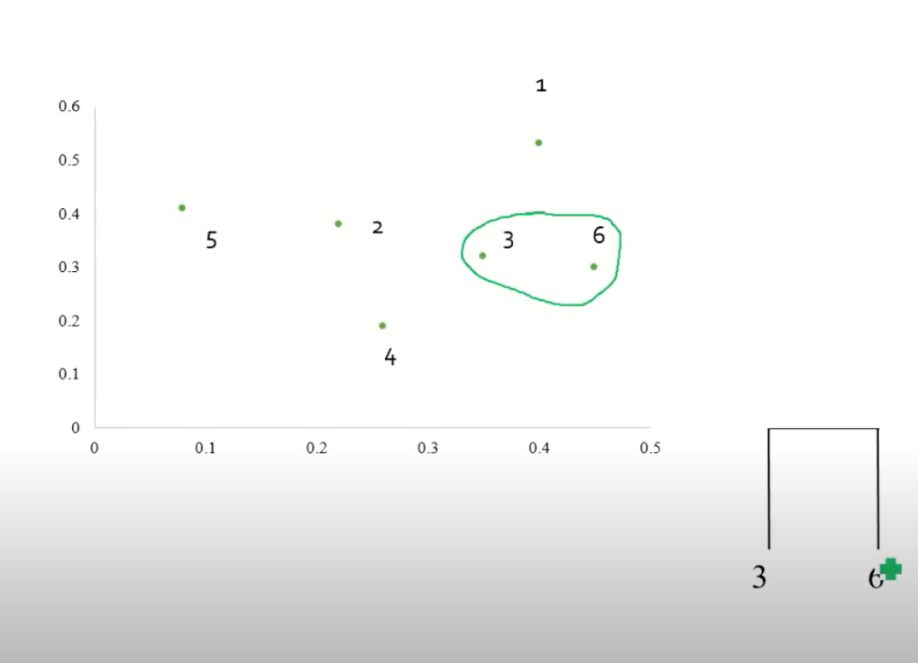

Slide 15
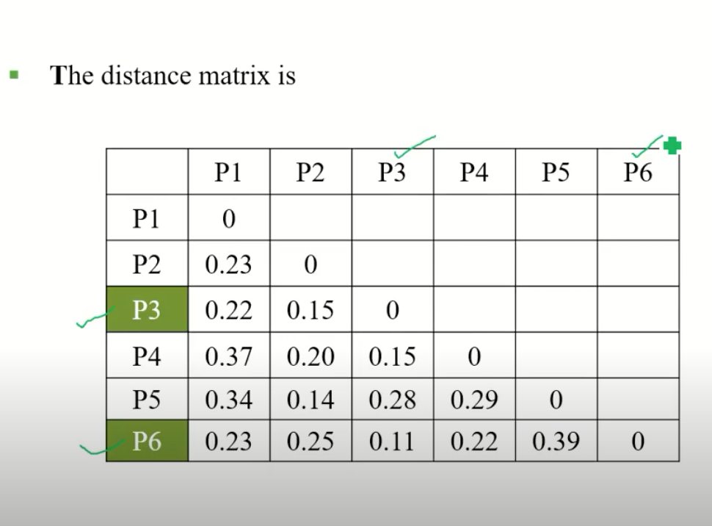

Slide 16
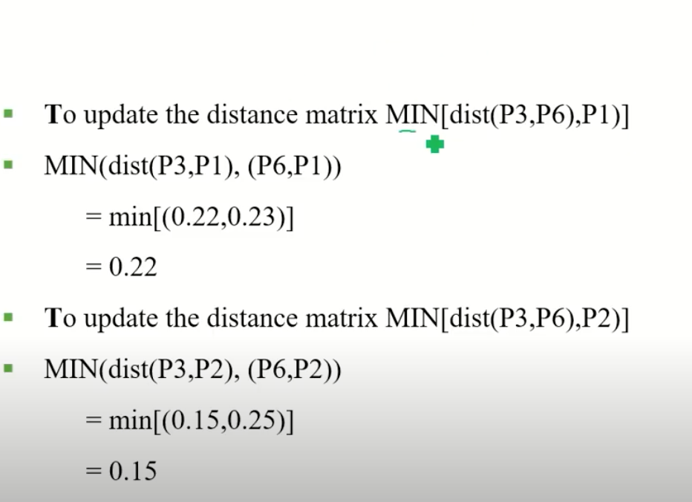

Slide 17
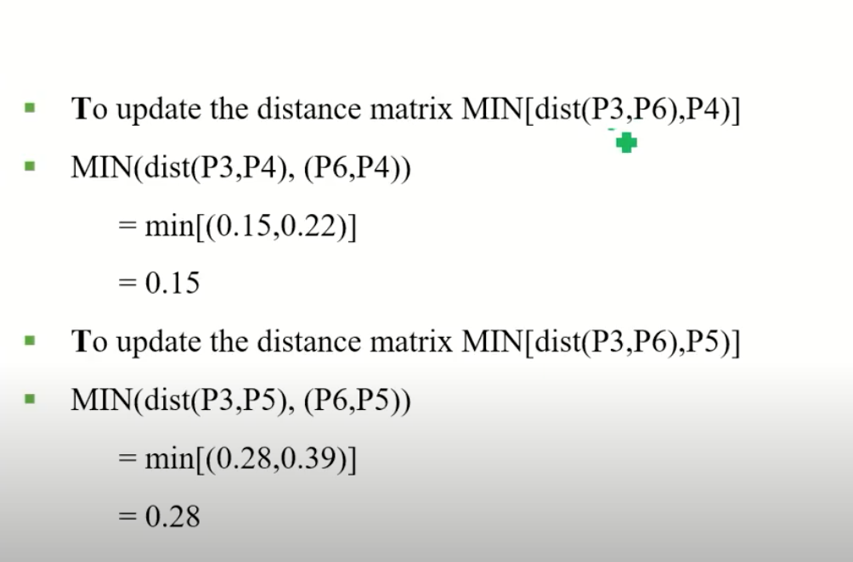

Slide 18
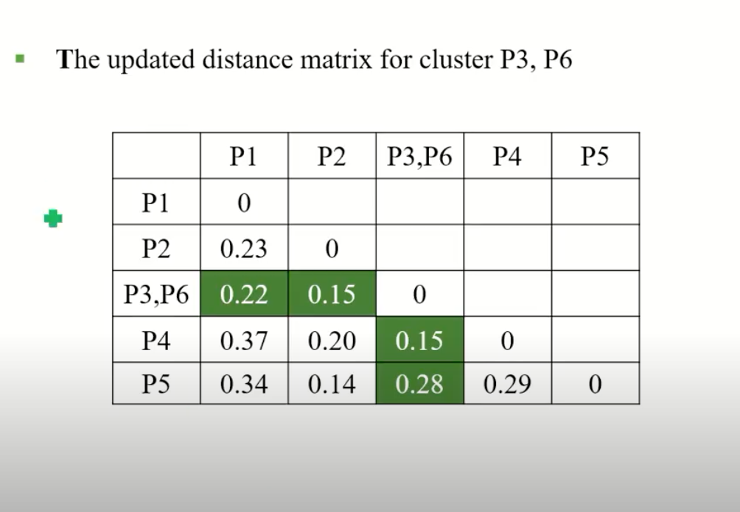

Slide 19
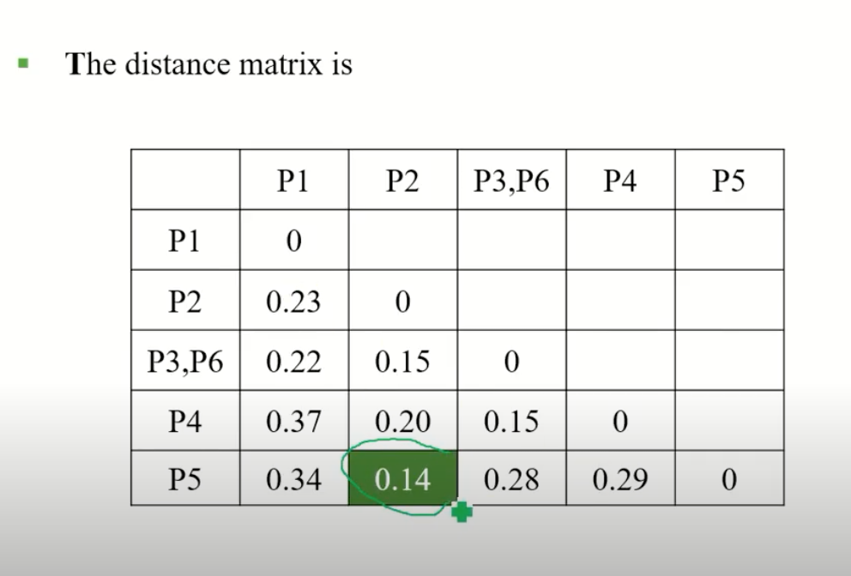

Slide 20
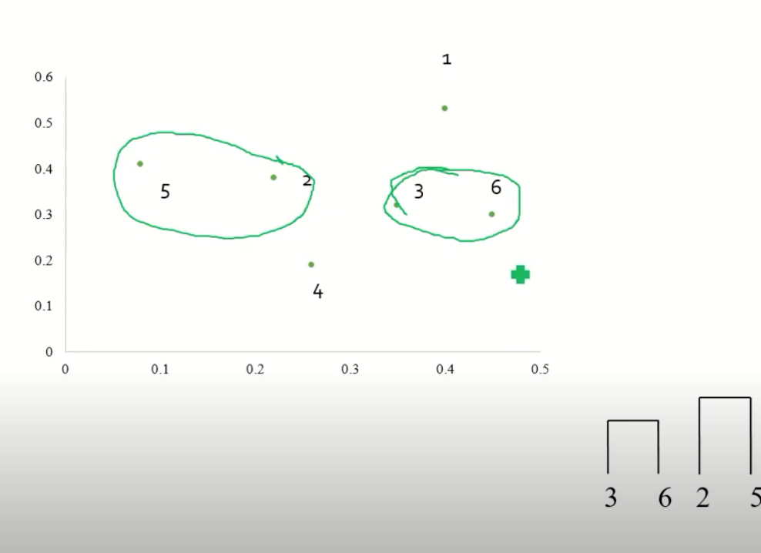

Slide 21
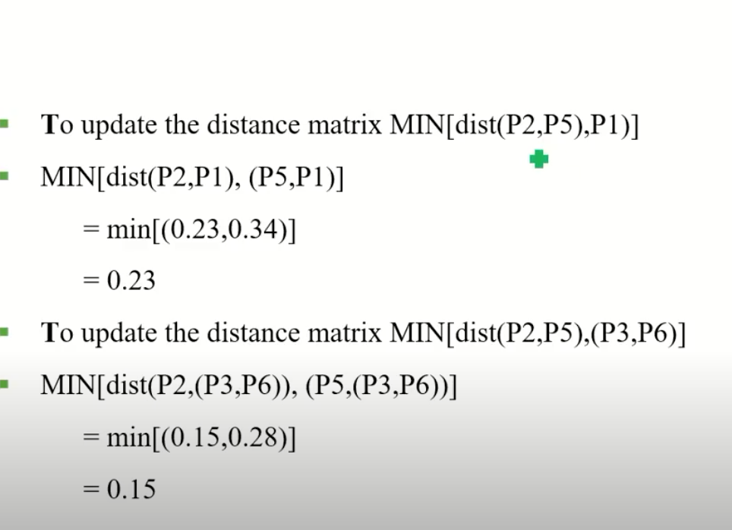

Slide 22
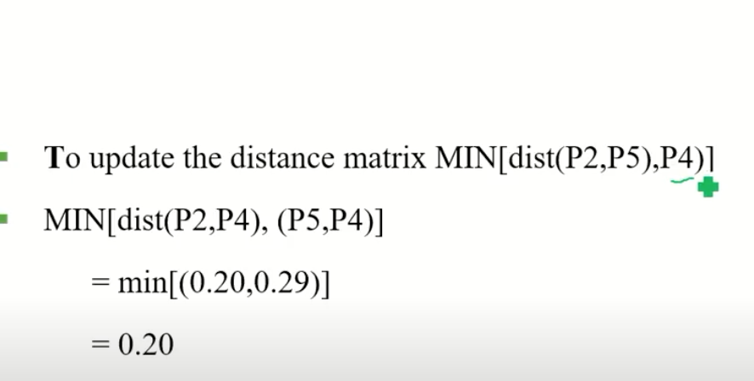

Slide 23
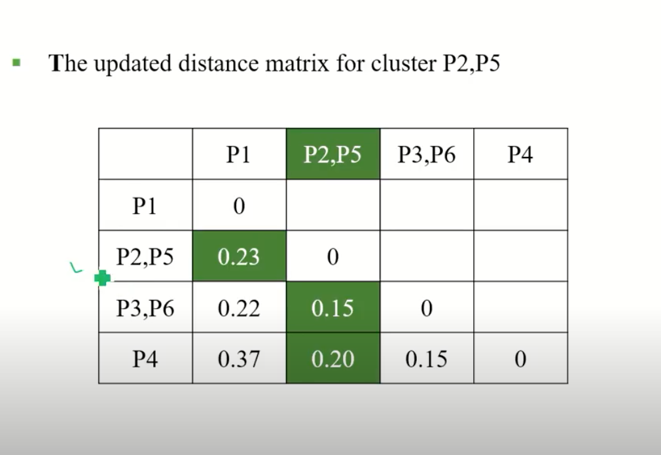

Slide 24
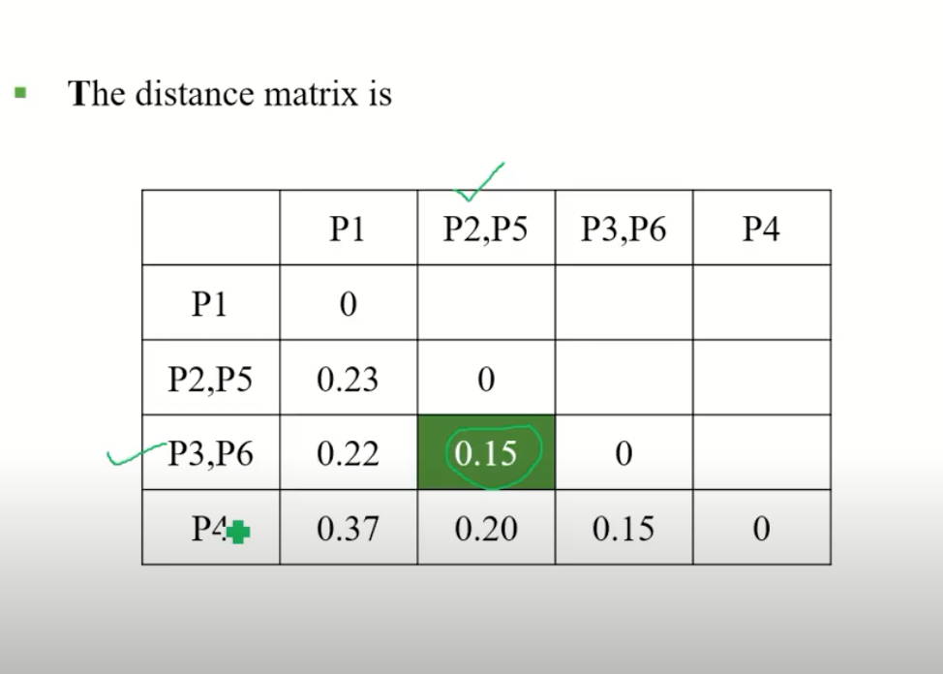

Slide 25
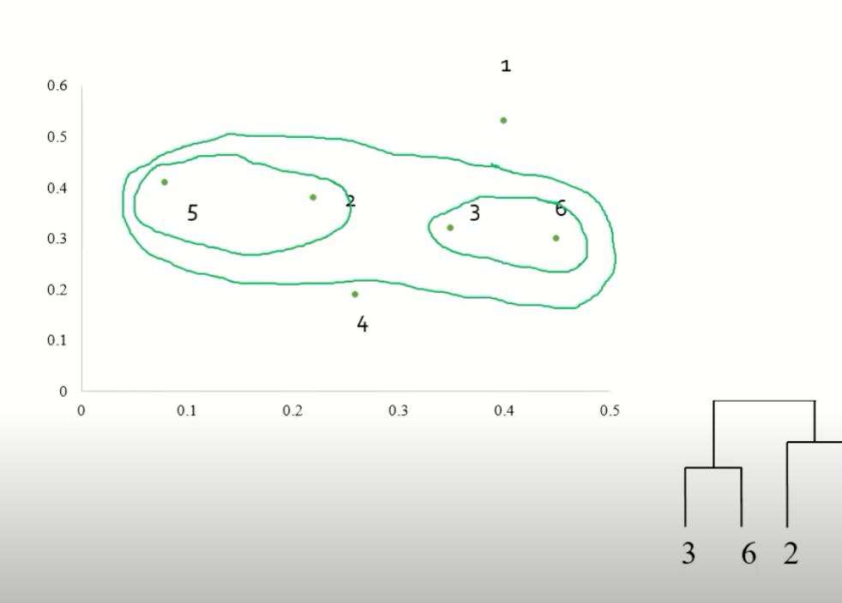

Slide 26
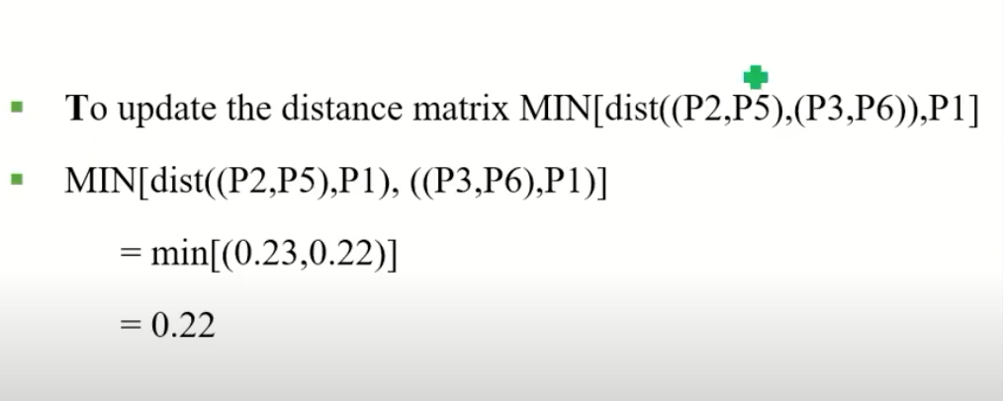

Slide 27
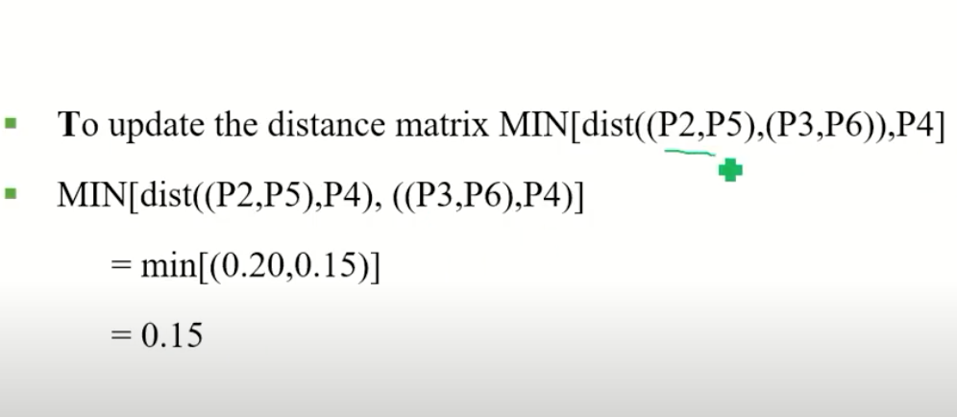

Slide 28
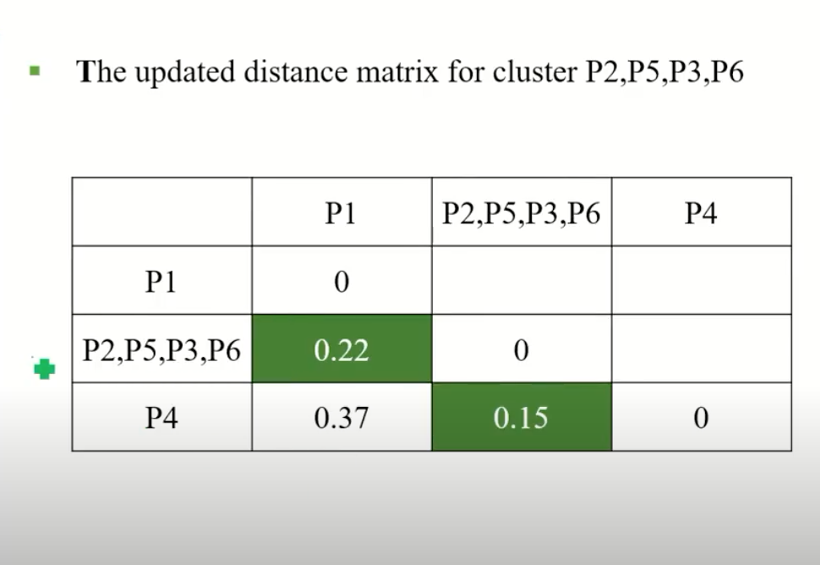

Slide 29
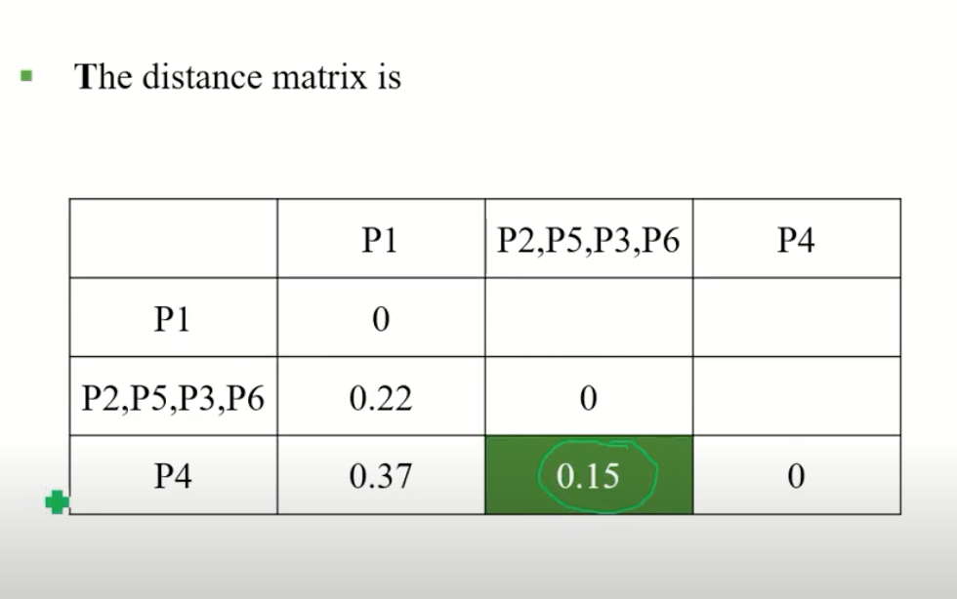

Slide 30
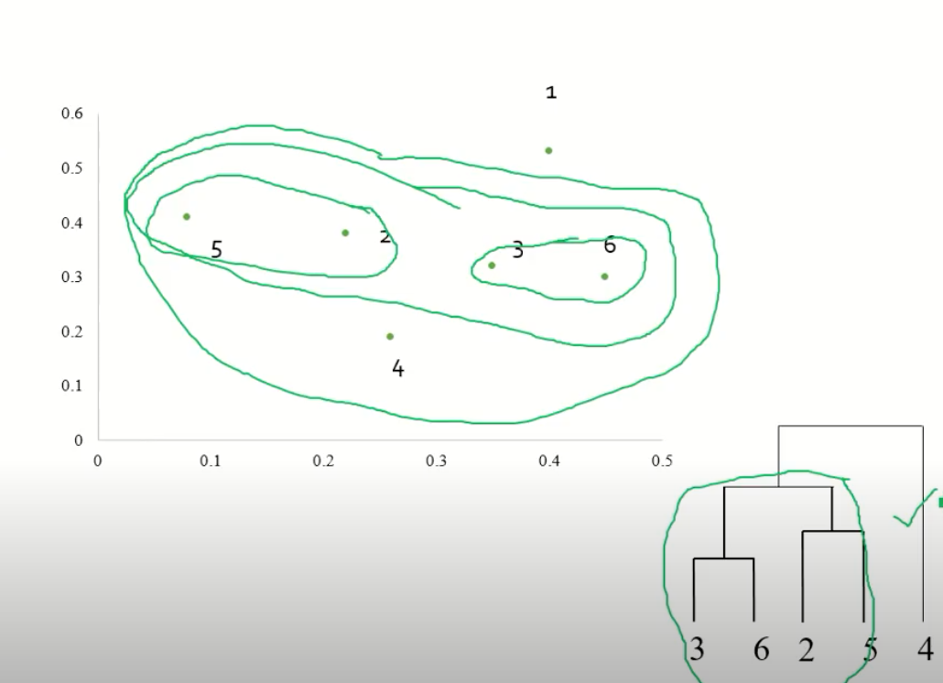

Slide 31
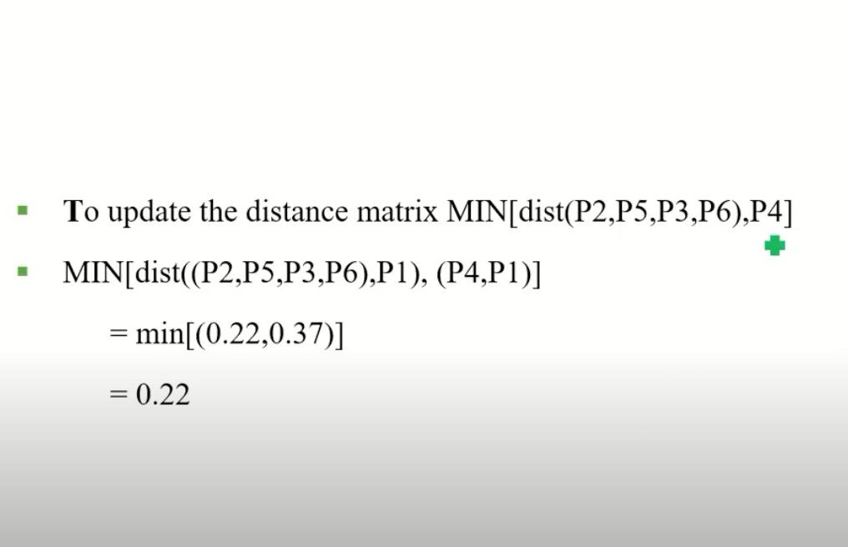

Slide 32
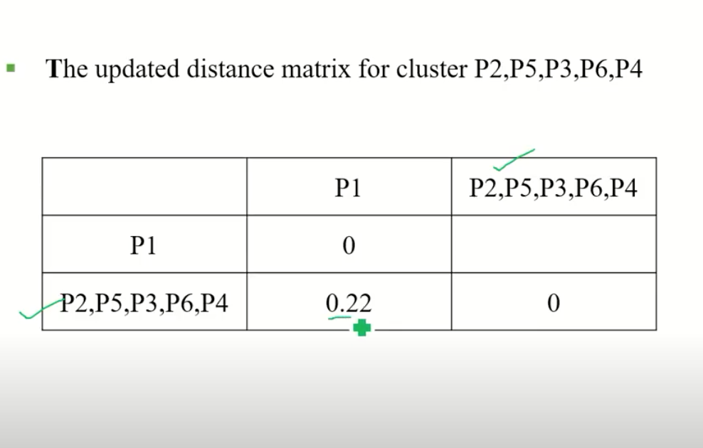

Slide 33
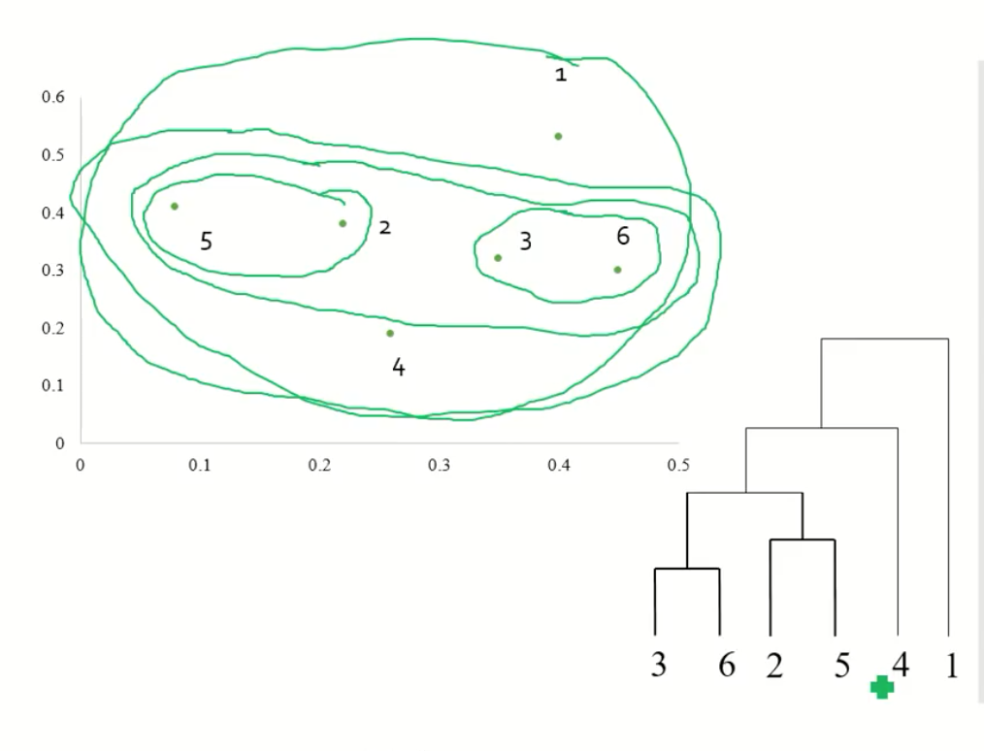

Slide 34
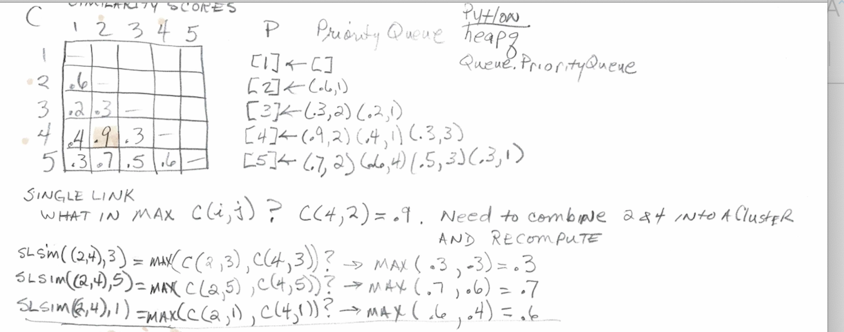

Slide 35
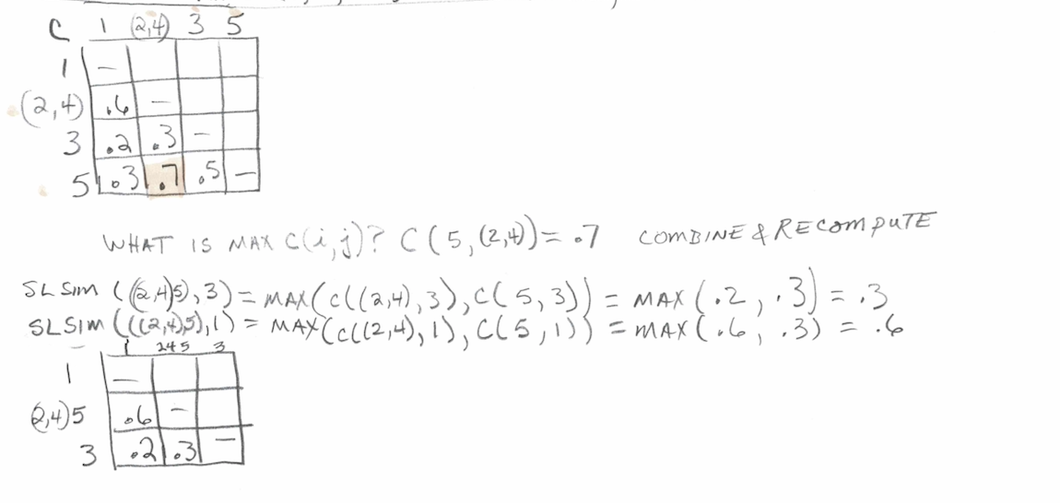

Slide 36
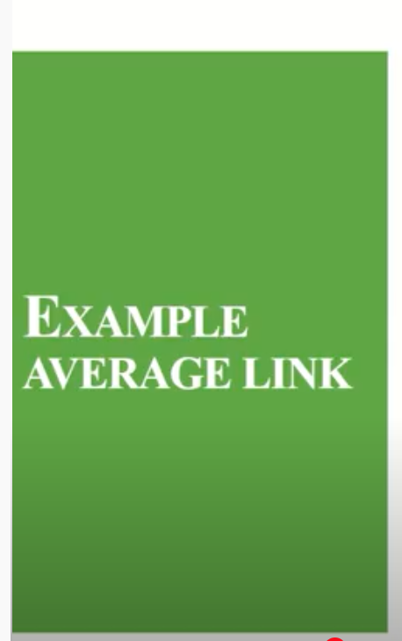
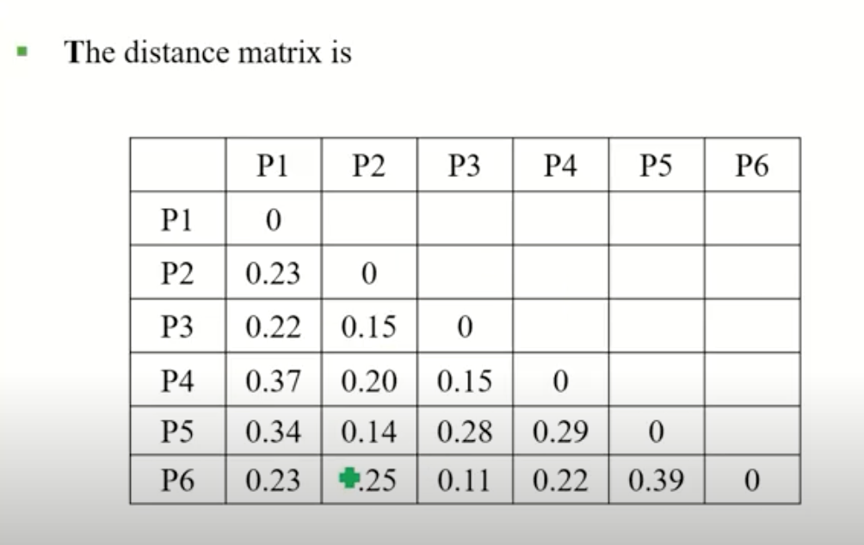
https://www.youtube.com/watch?v=T1ObCUpjq3o
Notes:
https://www.youtube.com/watch?v=T1ObCUpjq3o
Anuradha Bhatia
Hierarchical Agglomerative Clustering [HAC - Average Link]

Slide 37
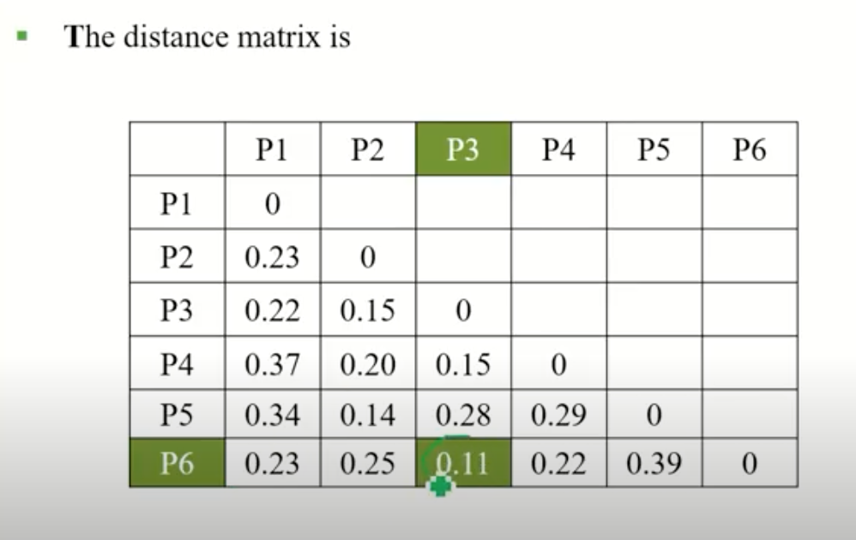

Slide 38
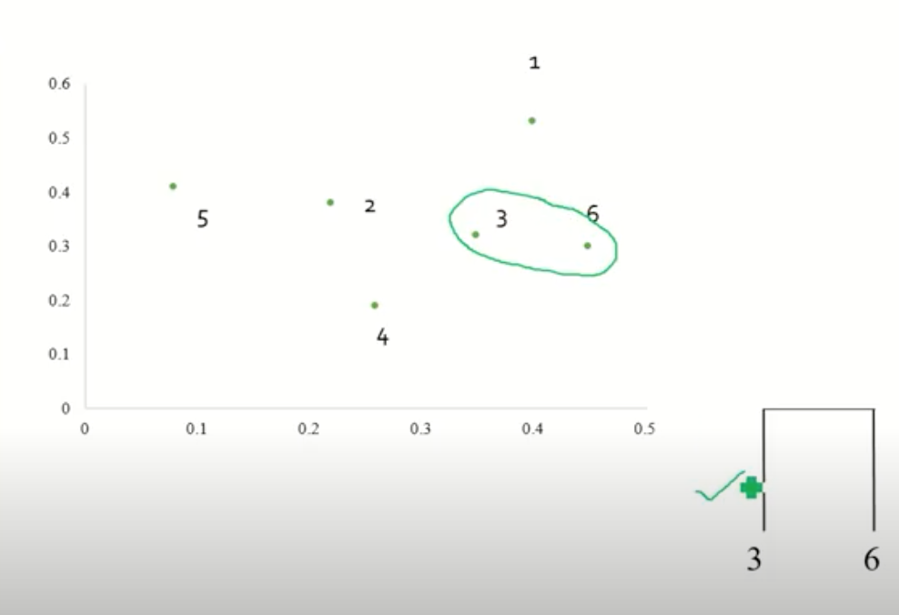

Slide 39
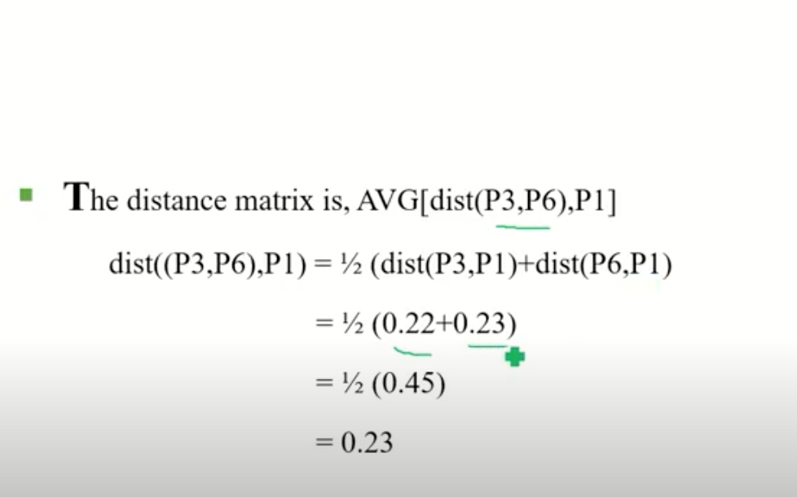

Slide 40
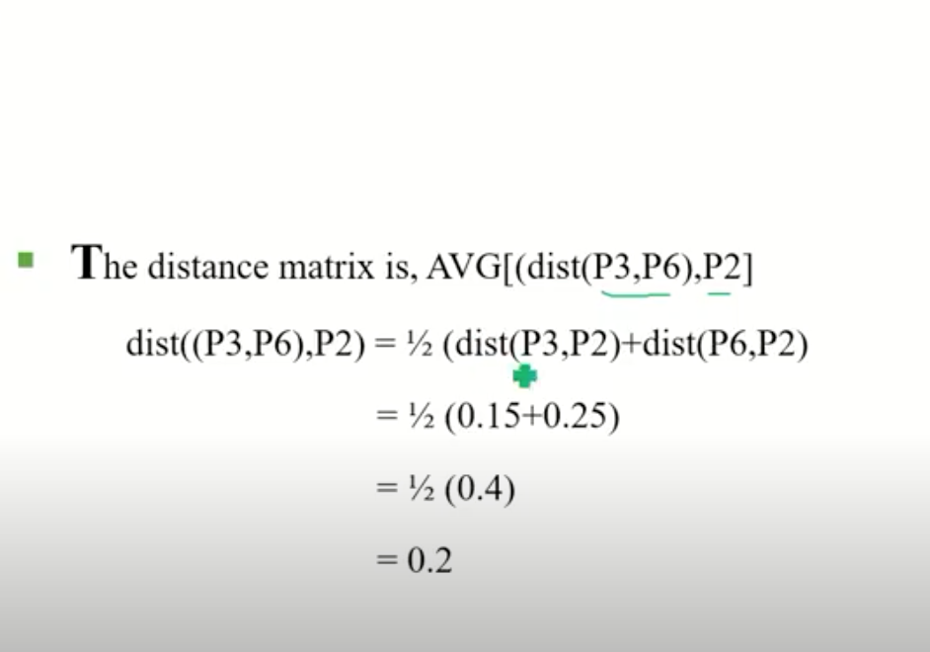

Slide 41
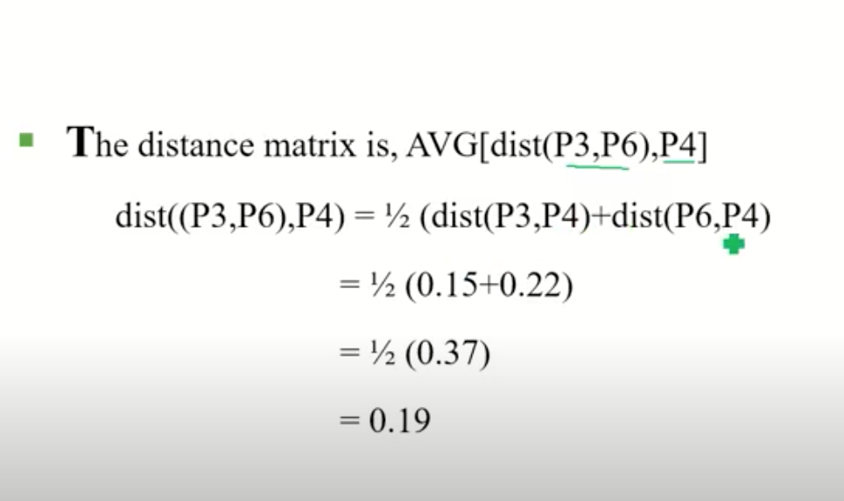

Slide 42
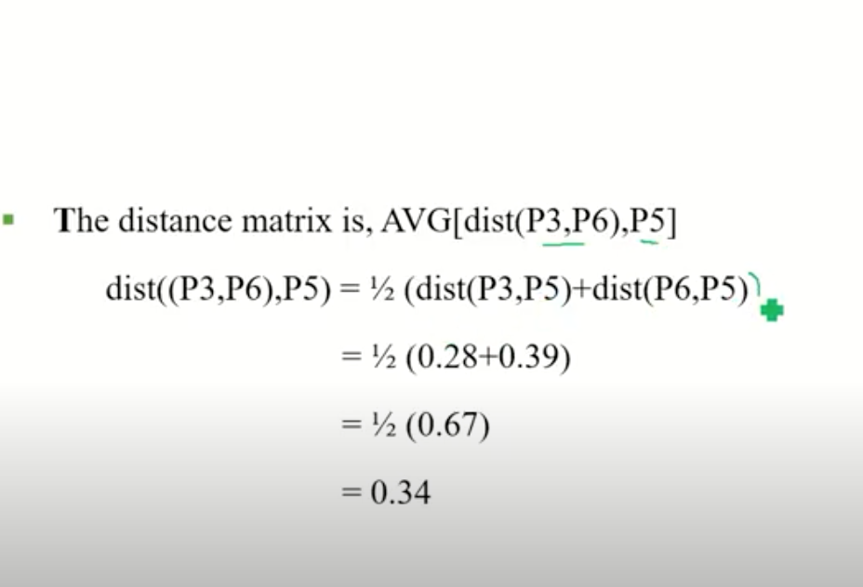

Slide 43
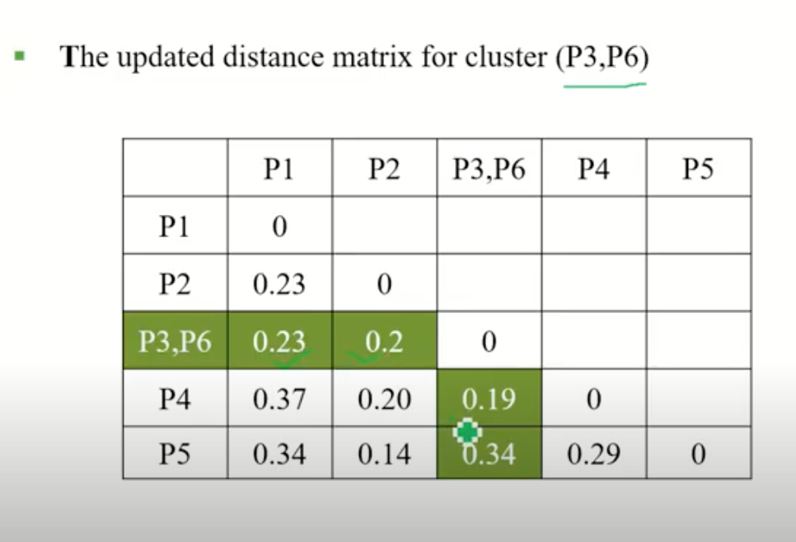

Slide 44
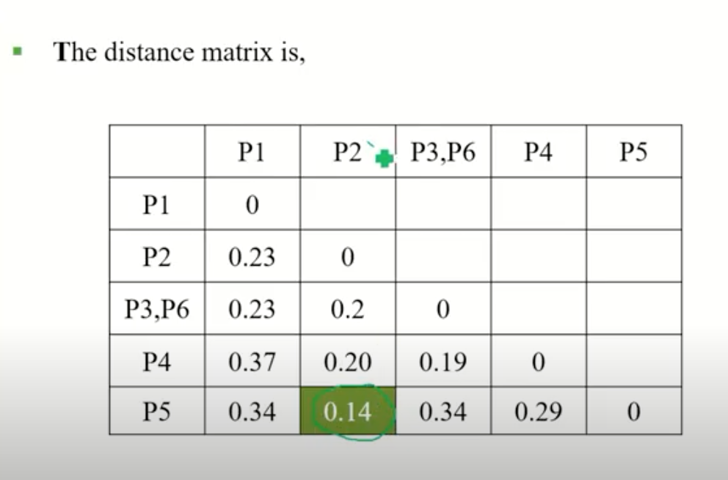

Slide 45
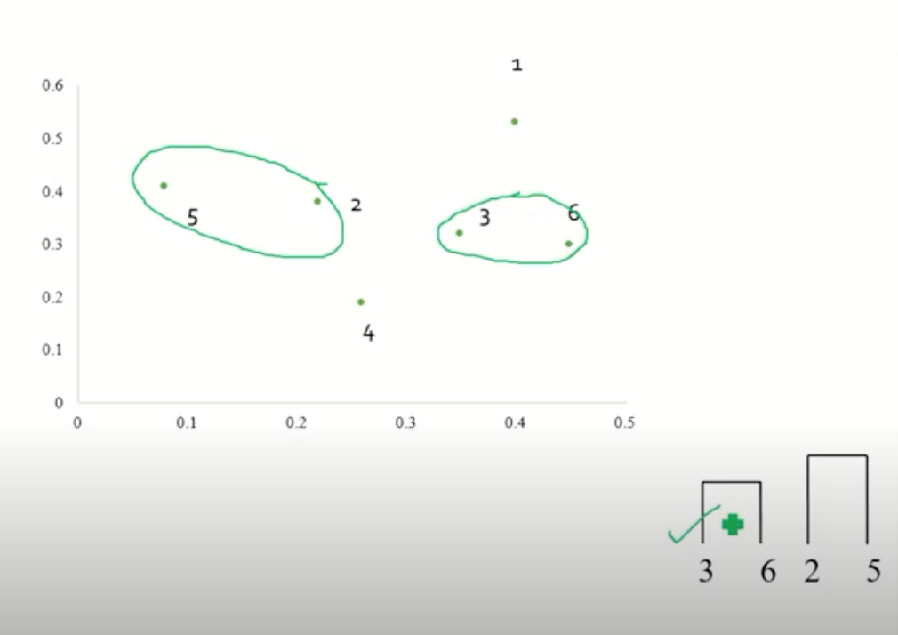

Slide 46
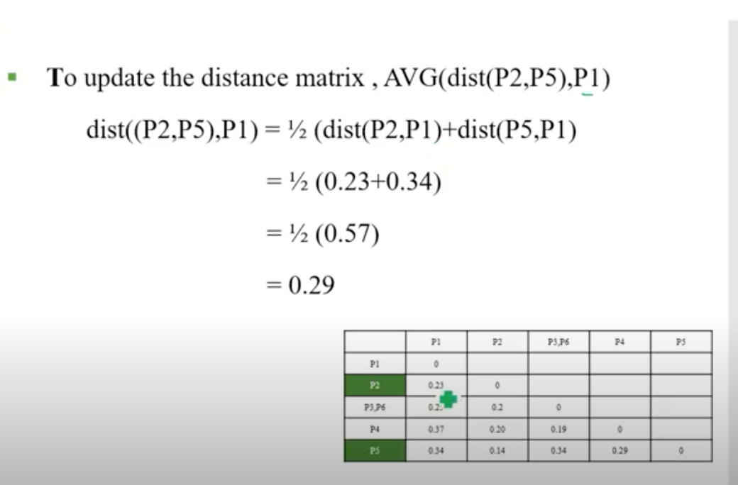

Slide 47
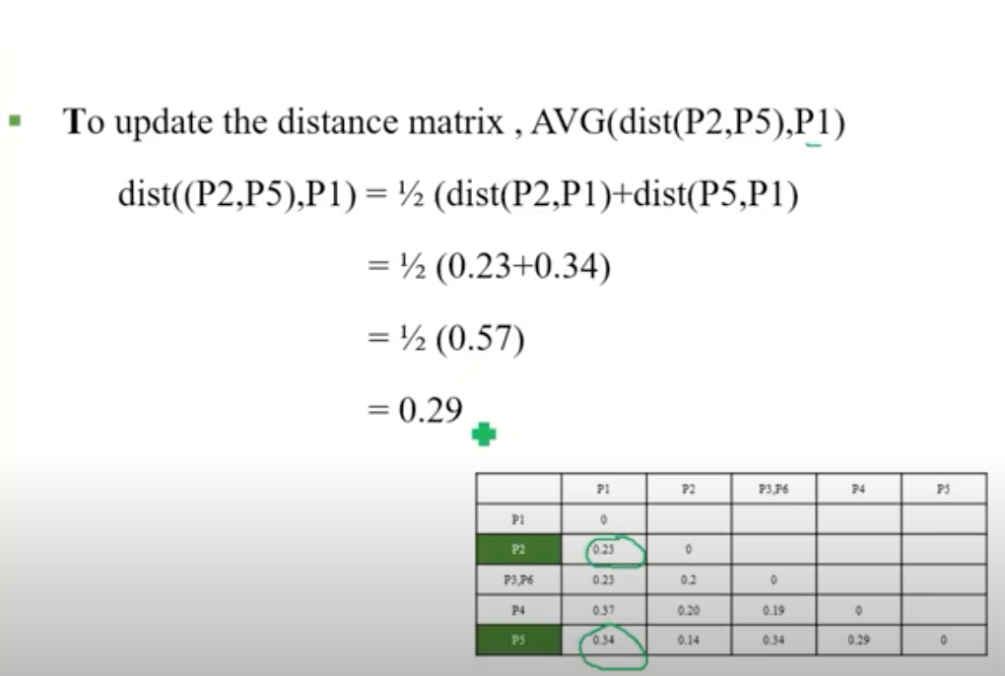

Slide 48
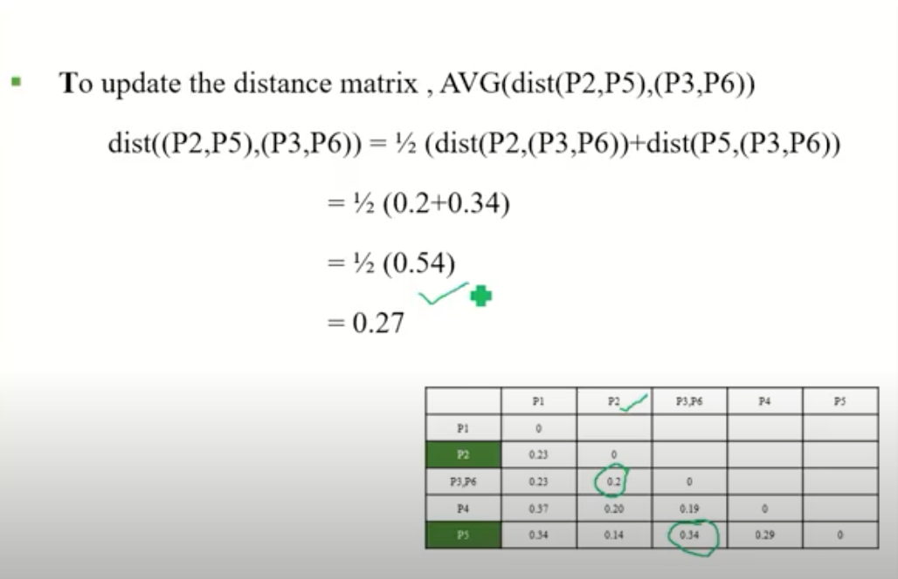

Slide 49
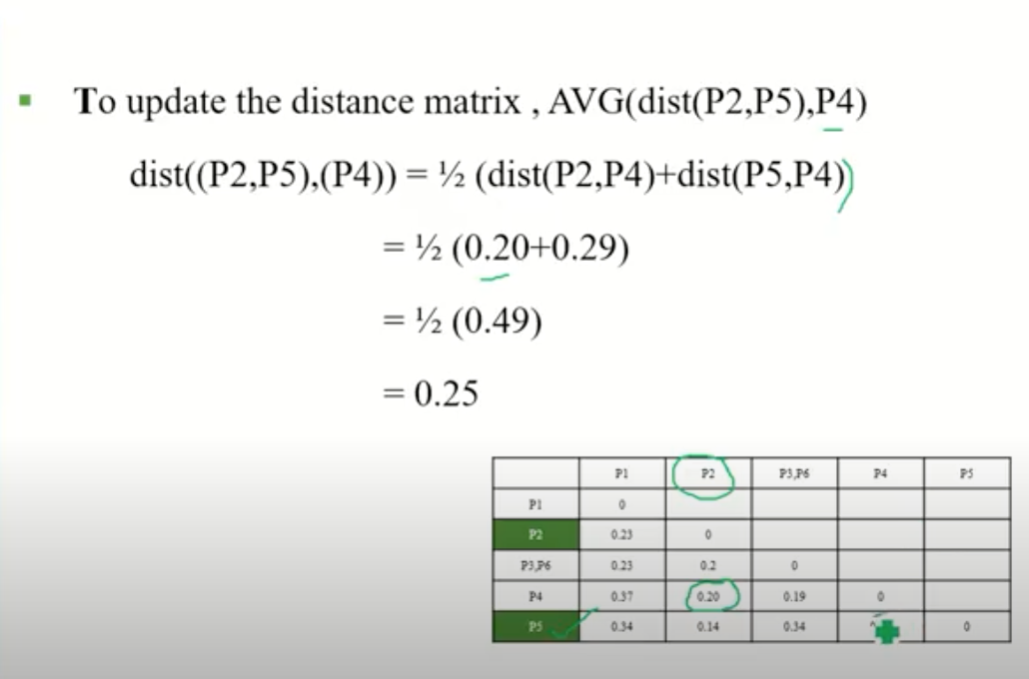

Slide 50
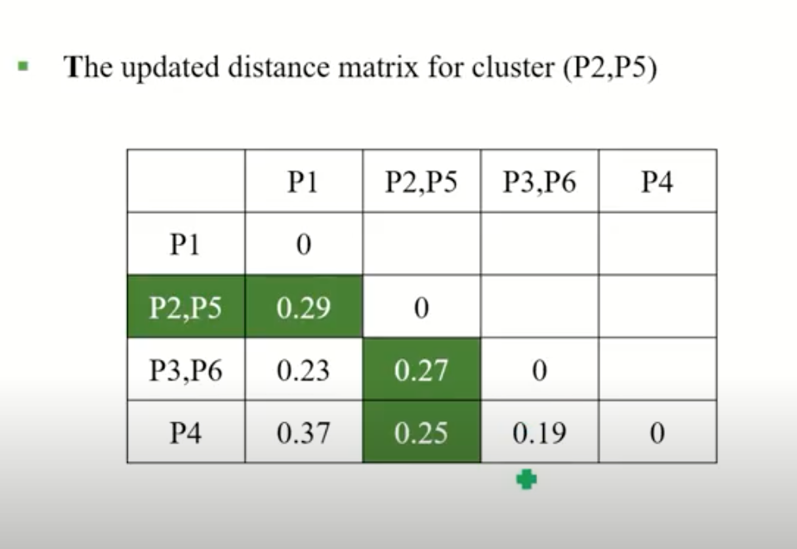

Slide 51


Slide 52


Slide 53


Slide 54


Slide 55


Slide 56


Slide 57


Slide 58


Slide 59


